Slide 1
File Organization & Indexing

Slide 2
DBMS stores data on hard disks
This means that data needs to be
read from the hard disk into memory (RAM)
Written from the memory onto the hard disk
Because I/O disk operations are slow query performance depends upon how data is stored on hard disks
The lowest component of the DBMS performs storage management activities
Other DBMS components need not know how these low level activities are performed
2

Slide 3
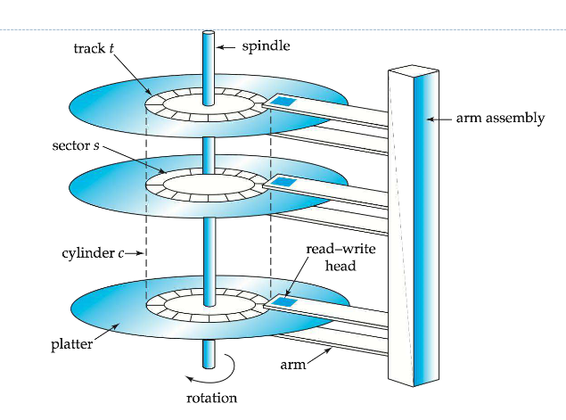
Basics of Data storage on hard disk
A disk is organized into a number of blocks or pages
A page is the unit of exchange between the disk and the main memory
A collection of pages is known as a file
DBMS stores data in one or more files on the hard disk

Slide 4
File Organization
The physical arrangement of data in a file into records and pages on the disk
File organization determines the set of access methods for
Storing and retrieving records from a file
We study three types of file organization
Unordered or Heap files
Ordered or sequential files
Hash files
We examine each of them in terms of the operations we perform on the database
Insert a new record
Search for a record (or update a record)
Delete a record

Slide 5
Organization of Records in Files
Heap – a record can be placed anywhere in the file where there is space
Sequential – store records in sequential order, based on the value of the search key of each record.
Hashing –
This function computed on some attribute of each record.
The term hash indicates splitting of key into pieces.
Records of each relation may be stored in a separate file.

Slide 6
Unordered Or Heap File
Records are stored in the same order in which they are created
Insert operation
Fast – because the incoming record is written at the end of the last page of the file
Search (or update) operation
Slow – because linear search is performed on pages
Delete Operation
Slow – because the record to be deleted is first searched
Deleting the record creates a hole in the page

Slide 7
Ordered or Sequential File
Records are sorted on the values of one or more fields
Ordering field – the field on which the records are sorted
Search (or update) Operation
Fast – because binary search is performed on sorted records
Delete Operation
Fast – because searching the record is fast
Insert Operation
Poor – because if we insert the new record in the correct position
we need to shift more than half the subsequent records in the file
Alternatively an ‘overflow file’ is created which contains all the new records as a heap
Periodically overflow file is merged with the main file

Slide 8
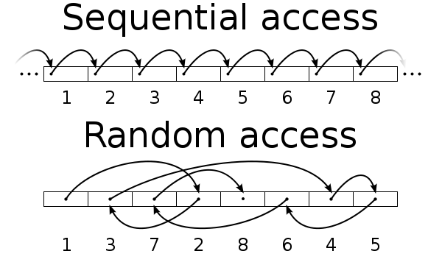
Sequential access vs random access .
sequential access means that a group of elements is accessed predetermined, ordered sequence
Random Access files will be spited in to pieces and will be stored wherever spaces available.
Sequential file may load faster and random access files may take time

Slide 9
Hash File
Is an array of buckets
Given a record, k a hash function, h(k) computes the index of the bucket in which record k belongs
h uses one or more fields in the record called hash fields
Hash key - the key of the file when it is used by the hash function
h(K)=K mod M
Example hash function
Assume that the staff last name is used as the hash field
Assume also that the hash file size is 26 buckets - each bucket corresponding to each of the letters from the alphabet
Then a hash function can be defined which computes the bucket address (index) based on the first letter in the last name.
9

Slide 10
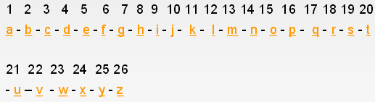
A bucket is a unit of storage containing one or more records
(a bucket is typically a disk block).
Hash function is used to locate records for access, insertion as well as deletion.
Hashing is an effective technique to calculate direct location of data record on the disk without using index structure.

Slide 11
Hash File
Insert Operation
Fast – because the hash function computes the index of the bucket to which the record belongs
If that bucket is full you go to the next free one
Search Operation
Fast – because the hash function computes the index of the bucket
Delete Operation
Fast – once again for the same reason of hashing function being able to locate the record quick

Slide 12
Internal Hashing:
Opening Addressing:
-Proceeding from occupied position specified by the hash address, program check the subsequent position in order until an unused empty position is found.
Chaining
-Various overflow locations are kept, usually by extending the array with number of overflow position
-A pointer field is added to each record location.
Multiple hashing:
External Hashing:
- Hashing for disk file is called External Hashing
- The Goal of good hashing function is to distribute the record uniformly over the address space so as to minimize collisions.

Slide 13
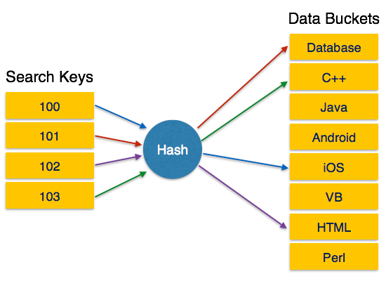
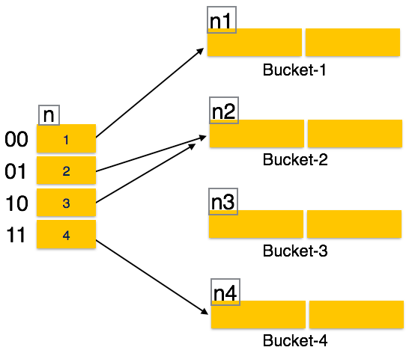
Static Hashing
!!! ….Problem with static hashing is that it does not expand or shrink dynamically as the size of database grows or shrinks….???
Dynamic Hashing
Dynamic hashing provides a mechanism in which data buckets are added and removed dynamically and on-demand(extended hashing)

Slide 14
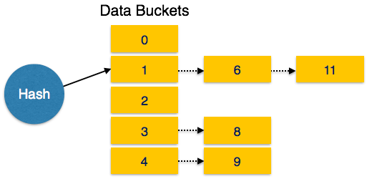
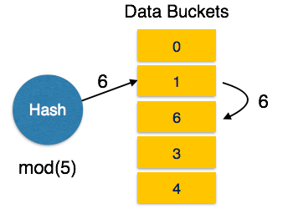
Overflow Chaining: When buckets are full, a new bucket is allocated for the same hash result and is linked after the previous one.
This mechanism is called Closed Hashing.
Linear Probing: When hash function generates an address at which data is already stored, the next free bucket is allocated to it.
This mechanism is called Open Hashing.

Slide 15
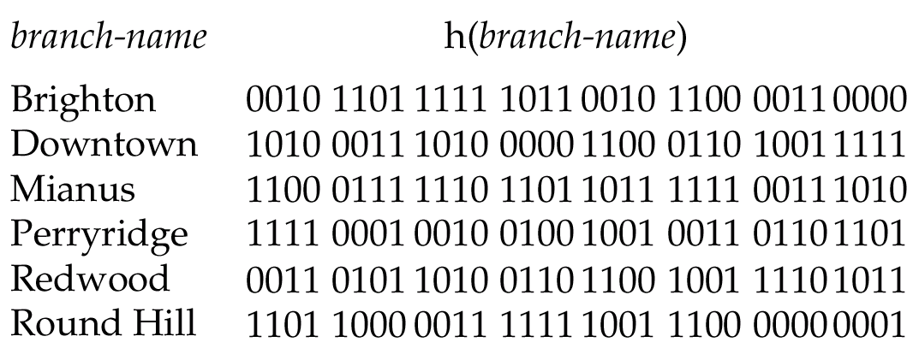
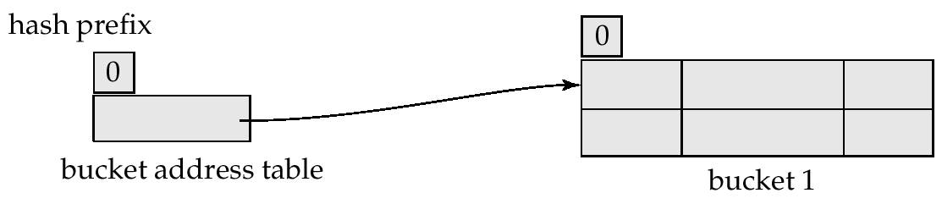
Hash file organization of account file, using branch_name as key
For a string search - key, the binary representations of all the characters in the string could be added and the sum modulo the number of buckets could be returned
Use of Extendable Hash Structure: Example
Initial Hash structure, bucket size = 2
15

Slide 16
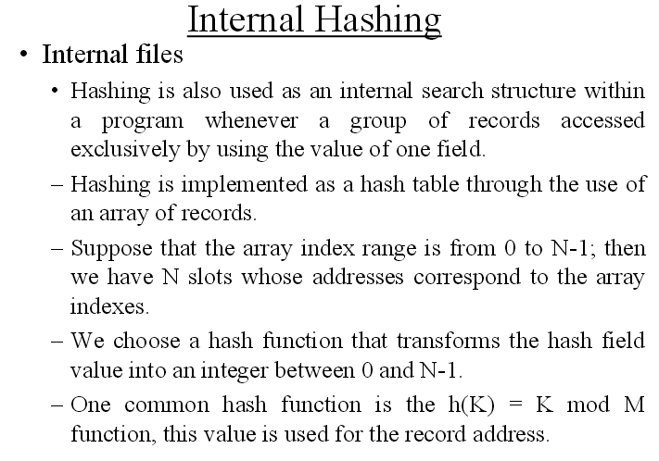

Slide 17
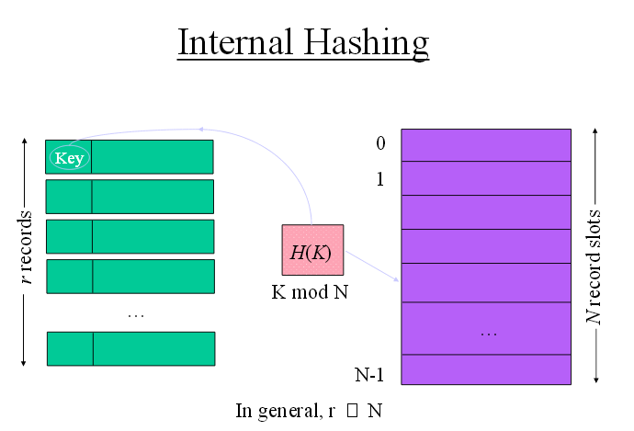

Slide 18
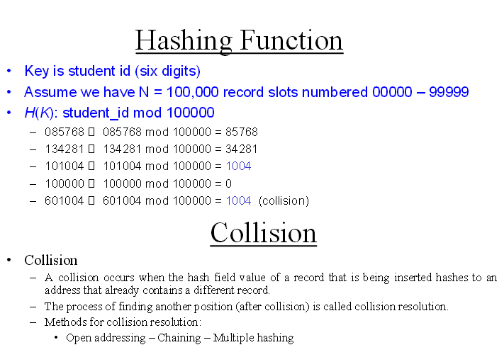

Slide 19
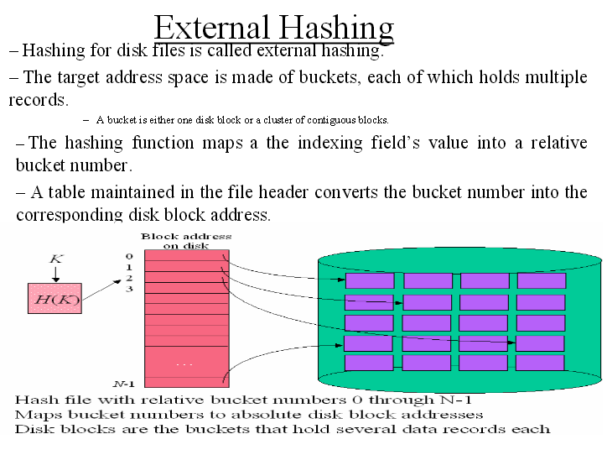

Slide 20
Indexing
• Index File (same idea as textbook index) : auxiliary structure designed to speed up access to desired data.
• Indexing field: field on which the index file is defined.
• Index file stores each value of the index field along with pointer
(eg:page no.) pointer(s) to block(s) that contain record(s) with that field value or pointer to the record with that field value:<Indexing Field, Pointer>
• To find a record in the data file based on a certain selection criterion on an indexing field , we initially access the index file, which will allow the access of the record on the data file.
• Index file much smaller than the data file => searching will be fast.
• Indexing important for file systems and DBMSs:

Slide 21
Choosing Indexing Technique
Five Factors involved when choosing the indexing technique:
access type
access time
insertion time
deletion time
space overhead

Slide 22
Two Types of Indices
Ordered index (Primary index or clustering index) – which is used to access data sorted by order of values.
Hash index (secondary index or non-clustering index ) - used to access data that is distributed uniformly across a range of buckets.

Slide 23
Types of Indexes
• Indexes on ordered vs. unordered files
• Dense vs. non-dense (i.e. sparse) indexes
- Dense: An entry in the index file for each record of the data file.
- Sparse: only some of the data records are represented in the index, often one index entry per block of the data file.
• Primary indexes vs. secondary indexes
• Ordered Indexes – Hash indexes
- Ordered Indexes: indexing fields stored in sorted order.
- Hash indexes: indexing fields stored using a hash function.
• Single-level vs. multi-level
– single-level index is an ordered file and is searched using binary search.
– multi-level ones are tree-structured that improve the search and require a more elaborate search algorithm.
• Index on a single indexing field –
Index on multiple indexing fields (i.e. Composite Index).

